Slide 1
STUDENT DETAILS
_____________________________________
NAME: KAPALAVAI NAGA VENKATA SATYA SRI SAI
ROLL NO: 22ME1A4631
BRANCH: CYBER SECURITY
EMAIL ID: KNVSSSAI51@GMAIL.COM
NAME OF THE COLLEGE: RAMACHANDRA COLLEGE OF
ENGINEERING(RCEE)

Slide 2

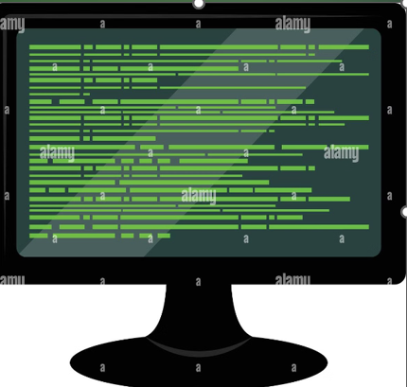
Hiding Text in Images: Steganography
Steganography is the art of hiding information inside other media, like images, to make it undetectable to the naked eye. This project explores a method for hiding text inside an image.

Slide 3


PROJECT TITLE: Text Steganography
1
Project Objective
2
Problem Statement
Develop a Python program to embed a secret text message within an image file.
How to securely hide sensitive information within a seemingly innocuous image.
3
Key Challenge
4
Target Audience
Balancing the message length with the image's integrity to ensure both remain intact.
Students and enthusiasts interested in learning about data security and steganography.

Slide 4
AGENDA
1
Project Setup
Define the necessary libraries, create the project structure, and select the image and text files.
2
Encoding Algorithm
Implement a steganography algorithm to embed the text message into the image file's pixel data.
3
Decoding Algorithm
Develop a counterpart algorithm to retrieve the hidden text message from the encoded image file.
4
Testing and Evaluation
Test the program with various image types and text lengths, analyze performance, and ensure both encoding and decoding work flawlessly.
5
Presentation
Document the project's code, explain the implementation, and showcase the working prototype.

Slide 5
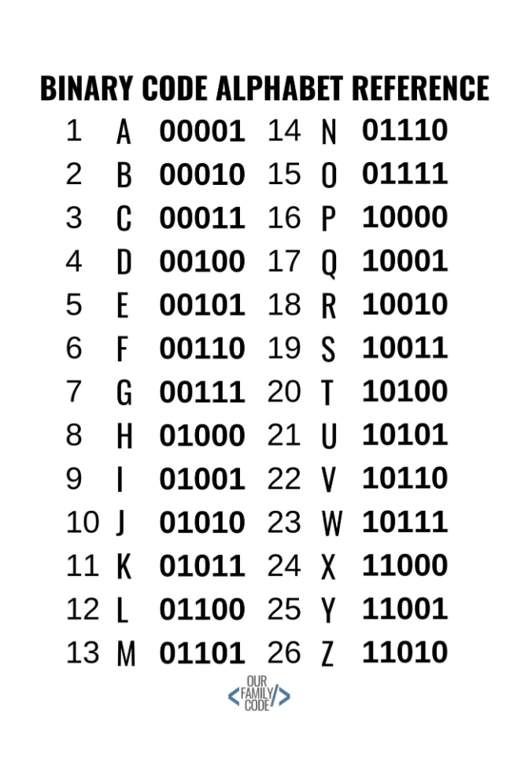

PROJECT OVERVIEW
Encoding
Decoding
The text message is converted into binary code. Then, each bit is embedded into the least significant bit (LSB) of the image's pixel data, effectively hiding it within the image's color information.
The image file is read, and the LSBs of each pixel are extracted. These bits are then reassembled to reconstruct the original text message. This process reverses the encoding, recovering the hidden message.

Slide 6



WHO ARE THE END USERS?
Security Enthusiasts
Computer Science Students
Individuals interested in exploring data hiding techniques and understanding the possibilities of steganography.
Students learning about algorithms and data structures, with a focus on image processing and information security.
Cybersecurity Professionals
Professionals working in cybersecurity who may need to detect or analyze steganographic techniques used in malicious activities.

Slide 7





YOUR SOLUTION AND ITS
VALUE PROPOSITION
Security
The hidden text is virtually undetectable to the naked eye, ensuring confidentiality and preventing unauthorized access.
Covert Communication
Provides a discreet way to transfer hidden messages, especially valuable in scenarios where open communication is restricted or monitored.
Data Integrity
The hidden text is not easily altered or corrupted, ensuring the integrity of the hidden message even when the image is slightly modified.

Slide 8

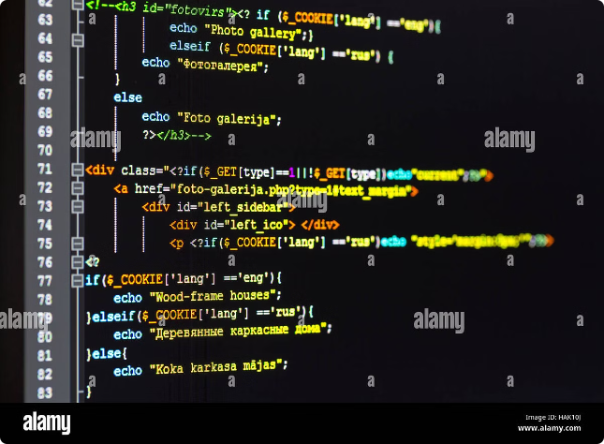
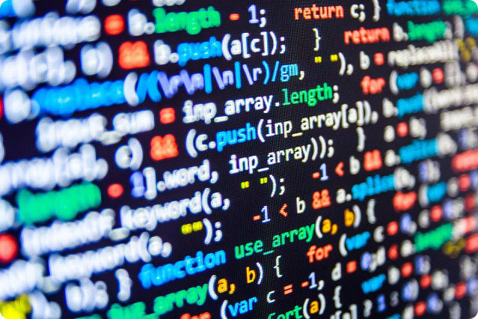
PROJECT CUSTOMIZE
Feature
Customization
Encoding Algorithm
Explored multiple steganography techniques, selecting the most efficient for this project's requirements.
Error Handling
Implemented robust error handling to address potential issues like image corruption or incorrect decoding.
User Interface
Designed a user-friendly interface for easily loading images, entering text, encoding, and decoding.

Slide 9



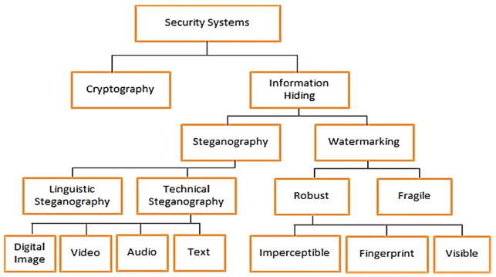


MODELLING
Image
Text Message
Represents the chosen image file for hiding the secret text message.
The secret message that will be embedded within the image's pixel data.
Algorithm
Security
The steganography algorithm used to embed the text into the image and retrieve it.
Focuses on the security aspects of the project, ensuring the hidden text is protected from unauthorized access.

Slide 10

RESULTS
Input and Output
Input
Output
Image File
Encoded Image File
Text Message
Decoded Text Message

Slide 11
LINKS

Slide 12


